Slide 1
Normalization
MODULE IV
Jacob P Cherian
Asst.Professor
Dept.of CSE, Saintgits College of Engineering

Slide 2
Contents/Syllabus
Different anomalies in designing a database, The idea of normalization, Functional dependency, Armstrong’s Axioms (proofs not required), Closures and their computation, Equivalence of
Functional Dependencies (FD), Minimal Cover (proofs not required).
First Normal Form (1NF), Second Normal Form (2NF), Third Normal Form (3NF), Boyce Codd Normal Form (BCNF)
Lossless join and dependency preserving decomposition, Algorithms for checking Lossless Join(LJ) and Dependency Preserving (DP) properties.

Slide 3
Guideline 1
Design a relation schema so that it is easy to explain its meaning. Do not combine attributes from multiple entity types and relationship types into a single relation.
If the relation corresponds to a mixture of multiple entities and relationships, semantic ambiguities will result and the relation cannot be easily explained.

Slide 4
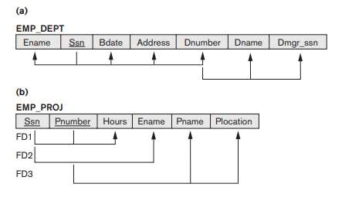
Example

Slide 5
Anomalies in Designing a DB
Insertion Anomaly
Deletion Anomaly
Updation Anomaly

Slide 6
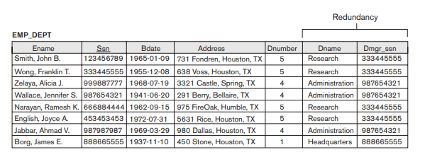
Example

Slide 7
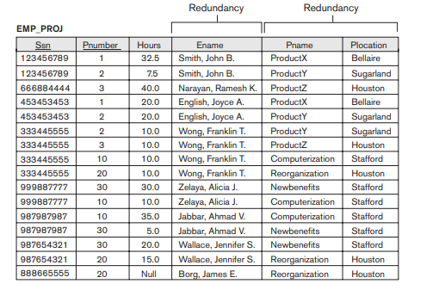
Example

Slide 8
Guideline 2
Design the base relation schemas so that no insertion, deletion, or modification anomalies are present in the relations.
If any anomalies are present, note them clearly and make sure that the programs that update the database will operate correctly.

Slide 9
Null Values in Tuples
Null values can waste space at the storage level and may also lead to problems with understanding the meaning of the attributes.
Difficulty to account for them when aggregate operations such as COUNT or SUM are applied.
SELECT and JOIN operations involve comparisons; if NULL values are present, the results may become unpredictable.6

Slide 10
Null Values in Tuples- Reasons
The attribute does not apply to this tuple.
For example, Visa_status may not apply to U.S. students.
The attribute value for this tuple is unknown.
For example, the Date_of_birth may be unknown for an employee.
The value is known but absent; that is, it has not been recorded yet.
For example, the Home_Phone_Number for an employee may exist, but may not be available and recorded yet.

Slide 11
Guideline 3
As far as possible, avoid placing attributes in a base relation whose values may frequently be NULL.
If NULLs are unavoidable, make sure that they apply in exceptional cases only and do not apply to a majority of tuples in the relation.

Slide 12
Functional Dependency - Idea
A functional dependency (FD) is a relationship between two attributes, typically between the PK and other non-key attributes within a table.
For any relation R, attribute Y is functionally dependent on attribute X (usually the PK), if for every valid instance of X, that value of X uniquely determines the value of Y.

Slide 13
Definition
Definition. A functional dependency, denoted by X → Y, between two sets of attributes X and Y that are subsets of R specifies a constraint on the possible tuples that can form a relation state r of R. The constraint is that, for any two tuples t1 and t2 in r that have t1[X] = t2[X], they must also have t1[Y] = t2[Y].

Slide 14
Functional Dependency - Idea
This relationship is indicated by the representation below :
X ———–> Y
The left side of the above FD diagram is called the determinant, and the right side is the dependent.

Slide 15
Example
X | Y
5 | 7
6 | 9
5 | 8
7 | 9
2 | 0
5 | 6
X | Y
1 | 7
2 | 6
3 | 6
1 | 7
4 | 8
2 | 6
X -> Y
X functionally determines Y

Slide 16
Types of Functional Dependencies
There are mainly four types of Functional Dependency in DBMS. Following are the types of Functional Dependencies in DBMS:
Multivalued Dependency
Trivial Functional Dependency
Non-Trivial Functional Dependency
Transitive Dependency

Slide 17
Multivalued Dependency
Multivalued dependency occurs when two attributes in a table are independent of each other but, both depend on a third attribute.
A multivalued dependency consists of at least two attributes that are dependent on a third attribute that's why it always requires at least three attributes.

Slide 18
Trivial Dependency
If a functional dependency (FD) X → Y holds, where Y is a subset of X, then it is called a trivial FD.
So, X -> Y is a trivial functional dependency if Y is a subset of X.

Slide 19
Non-Trivial Dependency
Nontrivial dependency occurs when A->B holds true where B is not a subset of A.
In a relationship, if attribute B is not a subset of attribute A, then it is considered as a non-trivial dependency.

Slide 20
Transitive Dependency
A functional dependency is said to be transitive if it is indirectly formed by two functional dependencies.
For eg: if A->B & B->C , then A-->C
The FD A-->C is a transitive dependency

